Slide 1
Struts

Slide 2
What is Struts?
Struts is a open source framework which make building of the web applications easier based on the java Servlet and JavaServer pages technologies.
Struts Frame work is the implementation of Model-View-Controller (MVC) design pattern .

Slide 3
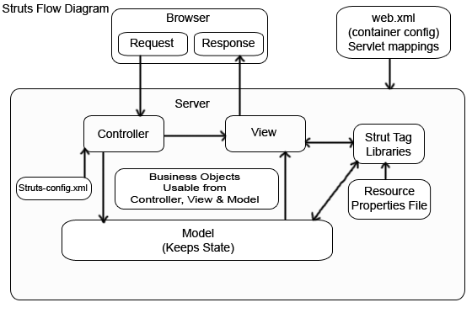

Slide 4
Struts MVC
3 Major Components
  Servlet controller (Controller)
  Java Server Pages (View)
  Application Business Logic (Model)
Controller bundles and routes HTTP request to other objects in framework (Actions)
Controller parses configuration file
Configuration file contains action mappings (determines navigation)
Struts is focused on Controller

Slide 5
Struts Action Forms
Action Forms are a Java Beans
Extends ActionForm class from Struts Framework
Action Forms are mapped to HTML forms – hence the name

Slide 6
Struts Action Forms
Extend org.apache.struts.action.ActionForm
Override:
  validate() - optional
Provide JavaBeans/style properties that match an HTML form input/output values

Slide 7
Struts Action
Extends: org.apache.struts.action.Action
Override method:
ActionForward execute(ActionMapping , ActionForm , HttpServletRequest , HttpServletResponse );

Slide 8
execute() Arguments
ActionMapping - provides access to the information stored in the configuration file (struts-config.xml) entry that configures this Action class.
ActionForm form—This is the form bean. By this time, the form bean has been pre-populated and the validate() method has been called and returned with no errors (assuming that validation is turned on). All the data entered by the user is available through the form bean.
HttpServletRequest request—This is the standard JSP or Servlet request object.
HttpServletResponse response—This is the standard JSP or Servlet response object.

Slide 9
struts-config.xml
<action-mappings>
<action path="/path"
type="Pack.MyAction"
name="MyForm"
input="/index.jsp">
<forward name="ok" path="/output.jsp"/>
<forware name="notok" path="/index.jsp"/>
</action>
</action-mappings>
Action mapping name
mapping type (Action)
Form Bean name
forward definition

Slide 10
First Example

Slide 11
web.xml
<init-param>
<param-name>config</param-name>
<param-value>/WEB-INF/struts-config.xml</param-value>
</init-param>
<jsp-config>
<taglib>
<taglib-uri>/WEB-INF/struts-html.tld</taglib-uri>
<taglib-location>/WEB-INF/struts-html.tld</taglib-location>
</taglib>
</jsp-config>

Slide 12
struts-config.xml
<struts-config>
<form-beans>
<form-bean name="MyForm" type="Pack.MyForm"/>
</form-beans>
<action-mappings>
<action path="/path" type="Pack.MyAction" name="MyForm" input="/index.jsp">
<forward name="ok" path="/output.jsp"/>
<forware name="notok" path="/index.jsp"/>
</action>
</action-mappings>
</struts-config>

Slide 13
index.jsp
<%@ taglib uri="WEB-INF/struts-html.tld" prefix="html"%>
<html> <body>
<html:form action="/path">
Number 1 :<html:text property="no1"/>
Number 2 :<html:text property="no2"/>
<html:submit/>
</html:form>
</body> </html>

Slide 14
ActionForm
public class MyForm extends org.apache.struts.action.ActionForm {
private int no1,no2;
public int getNo1() { return no1; }
public void setNo1(int no1) { this.no1 = no1; }
public int getNo2() { return no2; }
public void setNo2(int no2) { this.no2 = no2; }
}

Slide 15
Action Class
import javax.servlet.http.HttpServletRequest; import javax.servlet.http.HttpServletResponse;
import org.apache.struts.action.ActionForm; import org.apache.struts.action.ActionForward;
import org.apache.struts.action.ActionMapping;
public class MyAction extends org.apache.struts.action.Action {
private String msg="ok" ;
public ActionForward execute(ActionMapping mapping, ActionForm form,
HttpServletRequest request, HttpServletResponse response)
throws Exception {
MyForm f=(MyForm)form;
int n1=f.getNo1(); int n2=f.getNo2(); int sum=n1+n2;
request.setAttribute("Sum", sum);
return mapping.findForward(msg); } }

Slide 16
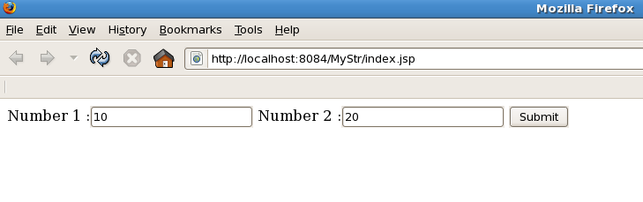
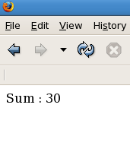
output.jsp
<html><body>
Sum : <%= request.getAttribute("Sum") %>
</body></html>

Slide 17
Struts Validation Example

Slide 18
web.xml
<init-param>
<param-name>config</param-name>
<param-value>/WEB-INF/struts-config.xml</param-value>
</init-param>
<jsp-config>
<taglib>
<taglib-uri>/WEB-INF/struts-html.tld</taglib-uri>
<taglib-location>/WEB-INF/struts-html.tld</taglib-location>
</taglib>
</jsp-config>

Slide 19
struts-config.xml
<struts-config>
<form-beans>
<form-bean name="MyForm" type="Pack.MyForm"/>
</form-beans>
<action-mappings>
<action path="/path" type="Pack.MyAction" name="MyForm" input="/index.jsp">
<forward name="ok" path="/output.jsp"/>
<forware name="notok" path="/index.jsp"/>
</action>
</action-mappings>
</struts-config>

Slide 20
index.jsp
<%@ taglib uri="WEB-INF/struts-html.tld" prefix="html" %>
<html> <body>
<html:form action="/path">
User Name :<html:text property="t1"/><br>
Password :<html:password property="t2"/><br>
<html:submit/>
<html:errors/>
</html:form>
</body> </html>

Slide 21
Action Form
public class MyForm extends org.apache.struts.action.ActionForm {
private String t1,t2;
public String getT1() { return t1; }
public void setT1(String t1) { this.t1 = t1; }
public String getT2() { return t2; }
public void setT2(String t2) { this.t2 = t2; }
public ActionErrors validate(ActionMapping mapping,
HttpServletRequest request) {
ActionErrors errors = new ActionErrors();
if (getT1()=="") {
errors.add("MyErrorMessage:User Name Required",
new ActionMessage("error.username.required")); }
if (getT2()=="") {
errors.add("MyErrorMessage: Password Required",
new ActionMessage("error.password.required")); } return errors; } }

Slide 22
Action Class
public class MyAction extends org.apache.struts.action.Action {
private String msg="ok" ;
public ActionForward execute(ActionMapping mapping, ActionForm form, HttpServletRequest request, HttpServletResponse response) throws Exception {
MyForm f=(MyForm)form;
String un=f.getT1();String ps=f.getT2();
request.setAttribute("UName", un);
request.setAttribute("Password", ps);
return mapping.findForward(msg);
} }

Slide 23
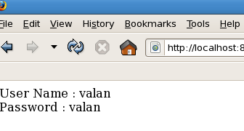
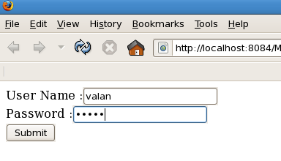
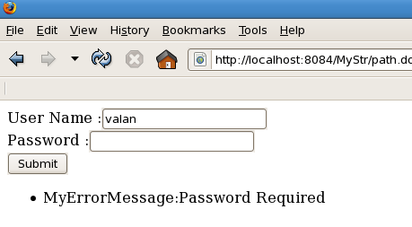
output.jsp
<body>
User Name : <%= request.getAttribute("UName") %><br>
Password : <%= request.getAttribute("Password") %>
</body>

Slide 24
Dyna Action Form

Slide 25
web.xml
<jsp-config>
<taglib>
<taglib-uri>/WEB-INF/struts-html.tld</taglib-uri>
<taglib-location>/WEB-INF/struts-html.tld</taglib-location>
</taglib>
</jsp-config>

Slide 26
struts-config.xml
<struts-config> <form-beans>
<form-bean name="MyDynaForm" type="org.apache.struts.action.DynaActionForm">
<form-property name="no1" type="java.lang.String"/>
<form-property name="no2" type="java.lang.String"/>
</form-bean> </form-beans>
<action-mappings>
<action path="/path" type="Pack.MyAction" name="MyDynaForm" input="/index.jsp">
<forward name="ok" path="/output.jsp"/>
<forward name="notok" path="/index.jsp"/>
</action> </action-mappings></struts-config>

Slide 27
index.jsp
<%@ taglib uri="WEB-INF/struts-html.tld" prefix="html" %>
<html> <body>
<html:form action="/path">
Number 1 :<html:text property="no1"/>
Number 2 :<html:text property="no2"/>
<html:submit/>
</html:form>
</body></html>

Slide 28
Action Class
public class MyAction extends org.apache.struts.action.Action {
private String msg ;
public ActionForward execute(ActionMapping mapping, ActionForm form,
HttpServletRequest request, HttpServletResponse response) throws Exception {
DynaActionForm f=(DynaActionForm)form;
String s1=(String)f.get("no1"); String s2=(String)f.get("no2");
if(s1.equals("") || s2.equals("")){ msg="notok"; }
else{
int sum=Integer.parseInt(s1)+Integer.parseInt(s2);
request.setAttribute("Sum", sum);
msg="ok"; }
return mapping.findForward(msg); } }

Slide 29
output.jsp
<body>
Sum : <%= request.getAttribute("Sum") %>
</body>

Slide 30
Dyna Action Form (Two Form)

Slide 31
web.xml
<jsp-config>
<taglib>
<taglib-uri>/WEB-INF/struts-html.tld</taglib-uri>
<taglib-location>/WEB-INF/struts-html.tld</taglib-location>
</taglib>
</jsp-config>

Slide 32
struts-config.xml
<form-beans>
<form-bean name="AdditionDynaForm" type="org.apache.struts.action.DynaActionForm">
<form-property name="no1" type="java.lang.String"/>
<form-property name="no2" type="java.lang.String"/>
</form-bean>
<form-bean name="SubtractionDynaForm" type="org.apache.struts.action.DynaActionForm">
<form-property name="no1" type="java.lang.String"/>
<form-property name="no2" type="java.lang.String"/>
</form-bean> </form-beans>

Slide 33
struts-config.xml
<action-mappings>
<action path="/path" type="Pack.AdditionAction" name="AdditionDynaForm" input="/addition.jsp">
<forward name="ok" path="/output.jsp"/>
<forward name="notok" path="/addition.jsp"/>
</action>
<action path="/path1" type="Pack.SubtractionAction" name="SubtractionDynaForm" input="/subtraction.jsp">
<forward name="ok" path="/output.jsp"/>
<forward name="notok" path="/subtraction.jsp"/>
</action> </action-mappings>

Slide 34
index.jsp
<html> <body>
<a href="addition.jsp">Addition</a><br>
<a href="subtraction.jsp">Subtraction</a>
</body> </html>
addition.jsp
<%@ taglib uri="WEB-INF/struts-
html.tld" prefix="html" %>
<html> <body>
<h2>Addition Form</h2><br>
<html:form action="/path">
Number 1 :<html:text property="no1"/>
Number 2 :<html:text property="no2"/>
<html:submit value="Add"/>
</html:form>
</body></html>
subtraction.jsp
<%@ taglib uri="WEB-INF/struts
-html.tld" prefix="html" %>
<html> <body>
<h2>Subtraction Form</h2><br>
<html:form action="/path1">
Number 1 :<html:text property="no1"/>
Number 2 :<html:text property="no2"/>
<html:submit value="Sub"/>
</html:form>
</body></html>

Slide 35
AdditionAction
public class AdditionAction extends org.apache.struts.action.Action {
private String msg;
public ActionForward execute(ActionMapping mapping, ActionForm form, HttpServletRequest request, HttpServletResponse response)
throws Exception {
DynaActionForm f=(DynaActionForm)form;
String s1=(String)f.get("no1"); String s2=(String)f.get("no2");
if(s1.equals("") || s2.equals("")){ msg="notok"; }
else{
msg="ok";
request.setAttribute("Ans", (Integer.parseInt(s1)+Integer.parseInt(s2))) ;
} return mapping.findForward(msg); } }

Slide 36
Subtraction Action
public class SubtractionAction extends org.apache.struts.action.Action {
private String msg;
public ActionForward execute(ActionMapping mapping, ActionForm form,
HttpServletRequest request, HttpServletResponse response)
throws Exception {
DynaActionForm f=(DynaActionForm)form;
String s1=(String)f.get("no1"); String s2=(String)f.get("no2");
if(s1.equals("") || s2.equals("")){ msg="notok"; }
else{
msg="ok";
request.setAttribute("Ans", (Integer.parseInt(s1)-Integer.parseInt(s2))) ;
} return mapping.findForward(msg); } }

Slide 37
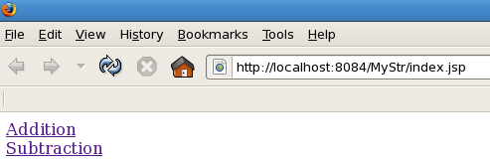
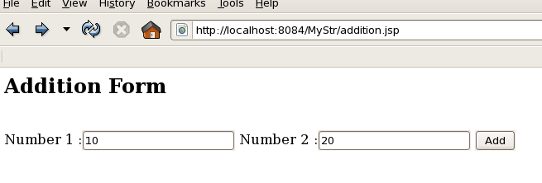
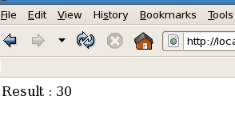
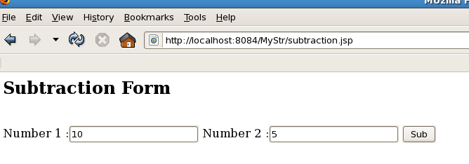
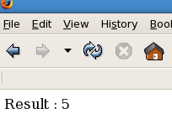
Output

Slide 38
Dispatch Action

Slide 39
web.xml
<jsp-config>
<taglib>
<taglib-uri>/WEB-INF/struts-html.tld</taglib-uri>
<taglib-location>/WEB-INF/struts-html.tld</taglib-location>
</taglib>
</jsp-config>

Slide 40
index.jsp
<%@ taglib uri="WEB-INF/struts-html.tld" prefix="html" %>
<html> <body>
<H3>Dispatch Action Example</H3>
<p><html:link page="/path.do?parameter=add">Call Add Section</html:link></p>
<p><html:link page="/path.do?parameter=edit">Call Edit Section</html:link></p>
<p><html:link page="/path.do?parameter=search">Call Search Section</html:link></p>
<p><html:link page="/path.do?parameter=save">Call Save Section</html:link></p>
</body> </html>

Slide 41
DispatchActionAdd.jsp
<body>
<h1>You are in add function.</h1>
</body>
DispatchActionEdit.jsp
<body>
<h1>You are in edit function.</h1>
</body>
DispatchActionSave.jsp
<body>
<h1>You are in save function</h1>
</body>
DispatchActionSearch.jsp
<body> <h1>You are in search function</h1> </body>

Slide 42
struts-config.xml
<form-beans>
<form-bean name="DispatchActionForm" type="Pack.DispatchActionForm">
</form-bean>
</form-beans>
<action-mappings>
<action path="/path" type="Pack.MyAction" parameter="parameter" name="DispatchActionForm" input="/index.jsp">
<forward name="add" path="/DispatchActionAdd.jsp" />
<forward name="edit" path="/DispatchActionEdit.jsp" />
<forward name="search" path="/DispatchActionSearch.jsp"/>
<forward name="save" path="/DispatchActionSave.jsp" /> </action> </action-mappings>

Slide 43
ActionForm
import org.apache.struts.action.ActionForm;
public class DispatchActionForm extends ActionForm {
private String parameter =" ";
public String getParameter()
{
return parameter;
}
public void setParameter(String parameter)
{
this.parameter=parameter;
} }

Slide 44
Action
import javax.servlet.http.HttpServletRequest; import javax.servlet.http.HttpServletResponse;
import org.apache.struts.actions.DispatchAction; import org.apache.struts.action.ActionForm;
import org.apache.struts.action.ActionForward; import org.apache.struts.action.ActionMapping;
public class MyAction extends DispatchAction{
public ActionForward add(ActionMapping mapping,ActionForm form,
HttpServletRequest request,HttpServletResponse response) throws Exception{
return mapping.findForward("add"); }
public ActionForward edit(ActionMapping mapping, ActionForm form, HttpServletRequest request, HttpServletResponse response) throws Exception {
return mapping.findForward("edit"); }
public ActionForward search(ActionMapping mapping,ActionForm form,
HttpServletRequest request,HttpServletResponse response) throws Exception{
return mapping.findForward("search"); }
public ActionForward save(ActionMapping mapping,ActionForm form,
HttpServletRequest request,HttpServletResponse response) throws Exception{
return mapping.findForward("save"); } }

Slide 45
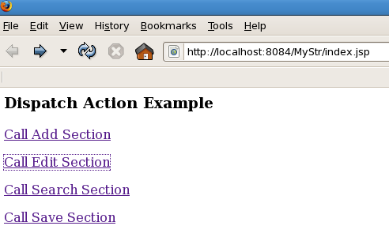
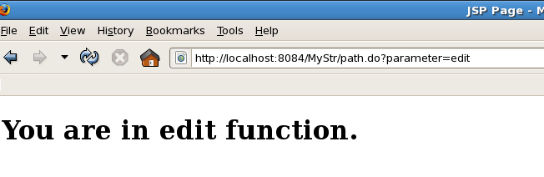
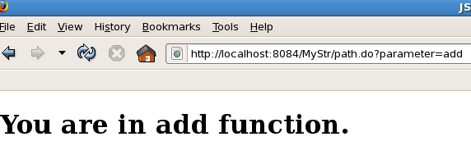
output

Slide 46
Dispatch Action with submit button

Slide 47
web.xml
<jsp-config>
<taglib>
<taglib-uri>/WEB-INF/struts-html.tld</taglib-uri>
<taglib-location>/WEB-INF/struts-html.tld</taglib-location>
</taglib>
</jsp-config>

Slide 48
index.jsp
<%@ taglib uri="WEB-INF/struts-html.tld" prefix="html" %>
<html> <body>
<H3>Dispatch Action Example</H3>
<html:form action="/path">
<html:text property="no1"/><br>
<html:text property="no2"/><br>
<html:submit value="Add" onclick="this.form.action='path.do?parameter=add';"/>
<html:submit value="Sub" onclick="this.form.action='path.do?parameter=sub';"/>
</html:form>
</body> </html>

Slide 49
DispatchActionAdd.jsp
<body>
<h1>You are in add function.</h1>
Result : <%= request.getAttribute("Ans") %>
</body>
DispatchActionSub.jsp
<body>
<h1>You are in Sub function.</h1>
Result : <%= request.getAttribute("Ans") %>
</body>

Slide 50
struts-config.xml
<form-beans>
<form-bean name="DispatchActionForm" type="Pack.DispatchActionForm">
</form-bean>
</form-beans>
<action-mappings>
<action path="/path" type="Pack.MyAction" parameter="parameter" name="DispatchActionForm" input="/index.jsp">
<forward name="add" path="/DispatchActionAdd.jsp" />
<forward name="sub" path="/DispatchActionSub.jsp" />
</action>
</action-mappings>

Slide 51
ActionForm
import org.apache.struts.action.ActionForm;
public class DispatchActionForm extends ActionForm {
private String parameter =" "; private int no1,no2;
public String getParameter() { return parameter; }
public void setParameter(String parameter) { this.parameter=parameter; }
public int getNo1() { return no1; }
public void setNo1(int no1) { this.no1 = no1; }
public int getNo2() { return no2; }
public void setNo2(int no2) { this.no2 = no2; }
}

Slide 52
Action
import javax.servlet.http.HttpServletRequest; import javax.servlet.http.HttpServletResponse;
import org.apache.struts.actions.DispatchAction; import org.apache.struts.action.ActionForm;
import org.apache.struts.action.ActionForward; import org.apache.struts.action.ActionMapping;
public class MyAction extends DispatchAction{
public ActionForward add(ActionMapping mapping,ActionForm form,
HttpServletRequest request,HttpServletResponse response) throws Exception{
DispatchActionForm f=(DispatchActionForm)form;
int n1=f.getNo1(); int n2=f.getNo2(); request.setAttribute("Ans", (n1+n2));
return mapping.findForward("add"); }
public ActionForward sub(ActionMapping mapping, ActionForm form,
HttpServletRequest request,HttpServletResponse response) throws Exception{
DispatchActionForm f=(DispatchActionForm)form;
int n1=f.getNo1(); int n2=f.getNo2(); request.setAttribute("Ans", (n1-n2));
return mapping.findForward("sub"); }}

Slide 53
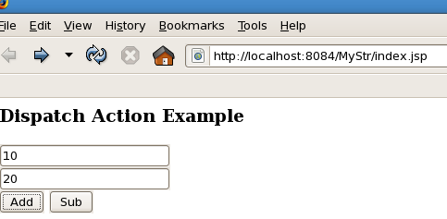
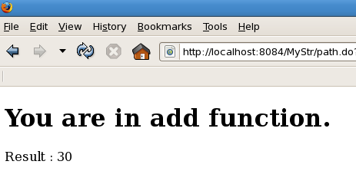
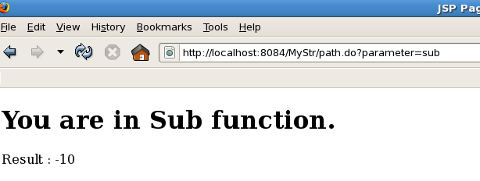
output

Slide 54
Struts Logic Tag

Slide 55
web.xml
<jsp-config>
<taglib>
<taglib-uri>/WEB-INF/struts-logic.tld</taglib-uri>
<taglib-location>/WEB-INF/struts-logic.tld</taglib-location>
</taglib>
</jsp-config>

Slide 56
struts-config.xml
<struts-config>
<form-beans>
<form-bean name="MyActionForm" type="Pack.MyActionForm"/>
</form-beans>
<action-mappings>
<action input="/index.jsp" name="MyActionForm" path="/path" type="Pack.MyAction">
<forward name="ok" path="/output.jsp"></forward>
</action>
</action-mappings>
</struts-config>

Slide 57
index.jsp
<%@ taglib uri="/WEB-INF/struts-html.tld" prefix="html" %>
<body> <html:form action="/path">
Name : <html:text property="name"/><br>
Age : <html:text property="age"/><br>
Hobbies :
<html:checkbox property="reading" value="Reading"/>Reading
<html:checkbox property="playing" value="Playing"/>Playing
<html:checkbox property="movie" value="Movie"/>Movie
<br><html:submit></html:submit>
</html:form> </body>

Slide 58
Action Form
public class MyActionForm extends org.apache.struts.action.ActionForm {
private String name,reading,playing,movie; private int age; private ArrayList list;
public String getName() { return name; }
public void setName(String name) { this.name = name; }
public int getAge() { return age; }
public void setAge(int age) { this.age = age; }
public ArrayList getList() { return list; }
public void setList(ArrayList list) { this.list = list; }
public String getReading() { return reading; }
public void setReading(String reading) { this.reading = reading; }
public String getPlaying() { return playing; }
public void setPlaying(String playing) { this.playing = playing; }
public String getMovie() { return movie; }
public void setMovie(String movie) { this.movie = movie; } }

Slide 59
Action Class
public class MyAction extends org.apache.struts.action.Action {
private String msg="ok";
public ActionForward execute(ActionMapping mapping, ActionForm form, HttpServletRequest request, HttpServletResponse response)
throws Exception {
MyActionForm f=(MyActionForm)form;
ArrayList hob=new ArrayList();
hob.add(f.getReading());
hob.add(f.getPlaying());
hob.add(f.getMovie());
f.setList(hob);
request.setAttribute("name", f.getName());
return mapping.findForward(msg); } }

Slide 60
Output.jsp
<%@ taglib uri="/WEB-INF/struts-logic.tld" prefix="logic" %>
<%@ taglib uri="/WEB-INF/struts-bean.tld" prefix="bean" %>
<body>
<logic:present name="MyActionForm" property="name" >
User name is <%= request.getAttribute("name") %>
</logic:present><br>
<logic:notPresent name="MyActionForm" property="name">
User name is not Available
</logic:notPresent><br>

Slide 61
output.jsp
<logic:match name="MyActionForm" property="name" value="valan">
User name is valan
</logic:match><br>
<logic:equal name="MyActionForm" property="age" value="18">
Age is 18
</logic:equal><br>
<logic:greaterThan name="MyActionForm" property="age" value="18">
Age is Greater than 18
</logic:greaterThan><br>

Slide 62
output.jsp
<logic:lessThan name="MyActionForm" property="name" value="18">
Age is Less than 18
</logic:lessThan><br>
Hobbies:<br>
<logic:iterate name="MyActionForm" property="list" id="data">
<bean:write name="data"/>
</logic:iterate>
</body>

Slide 63
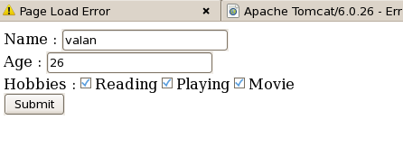
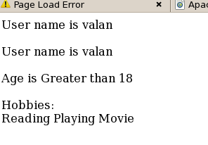
output

Slide 64
Struts Tiles

Slide 65
What is Struts Tiles?
Tiles is a framework for the development user interface.
Tiles is enables the developers to develop the web applications by assembling the reusable tiles (jsp, html, etc..).
Tiles uses the concept of reuse and enables the developers to define a template for the web site and then use this layout to populate the content of the web site.

Slide 66
Steps To Create Tiles Application
Tiles is very useful framework for the development of web applications. Here are the steps necessary for adding Tiles to your Struts application:
1. Add the Tiles Tag Library Descriptor (TLD) file to the web.xml.
2. Create layout JSPs.
3. Develop the web pages using layouts.
4. Repackage, run and test application.

Slide 67
web.xml
<jsp-config>
<taglib>
<taglib-uri>/WEB-INF/struts-tiles.tld</taglib-uri>
<taglib-location>/WEB-INF/struts-tiles.tld </taglib-location>
</taglib>
</jsp-config>

Slide 68
Layout (template.jsp)
<%@taglib uri="/WEB-INF/struts-tiles.tld" prefix="tiles" %>
<body><table border="1" cellpadding="2" cellspacing="2" align="center">
<tr><td height="20%" colspan="2">
<tiles:insert attribute="header" ignore="true" /></td> </tr>
<tr>
<td width="20%" height="250"><tiles:insert attribute="menu" /></td>
<td> <tiles:insert attribute="body" /> </td> </tr>
<tr><td height="20%" colspan="2">
<tiles:insert attribute="footer" /></td> </tr>
</table> </body>

Slide 69
HomePage.jsp
<%@taglib uri="/WEB-INF/struts-tiles.tld" prefix="tiles" %>
<body>
<tiles:insert template="template.jsp" flush="true">
<tiles:put name="title" value="Tiles Example" />
<tiles:put name="header" value="header.jsp" />
<tiles:put name="menu" value="menu.jsp" />
<tiles:put name="body" value="body.jsp" />
<tiles:put name="footer" value="footer.jsp" />
</tiles:insert>
</body>

Slide 70
header.jsp
<body>
<h1>Header JSP</h1>
</body>
menu.jsp
<body>
<h1>Menu JSP</h1>
</body>
body.jsp
<body>
<h1>Body JSP</h1>
</body>
footer.jsp
<body>
<h1>Footer JSP</h1>
</body>

Slide 71
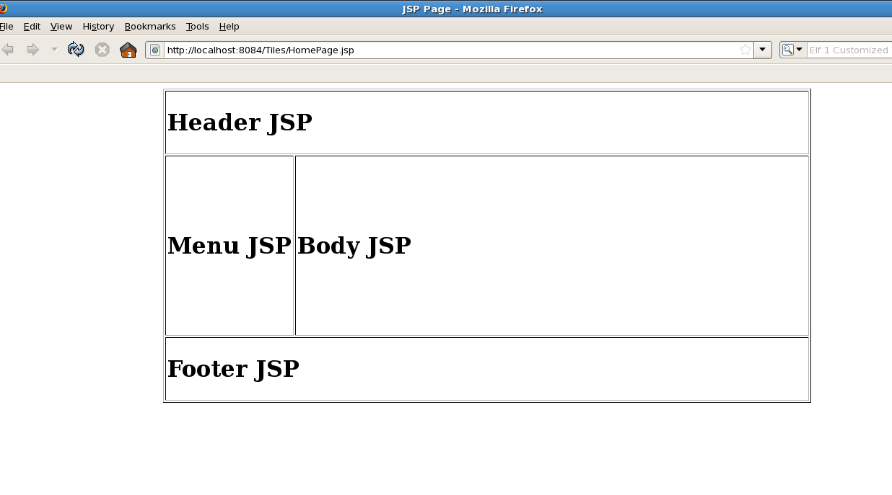
Output

